Slide 1
The Driver [group:07]
Abu Ubaida Akash (17.01.04.060)
Dewan Tanjil Hossain (17.01.04.072)
Joy Mondal (17.01.04.073)

Slide 2
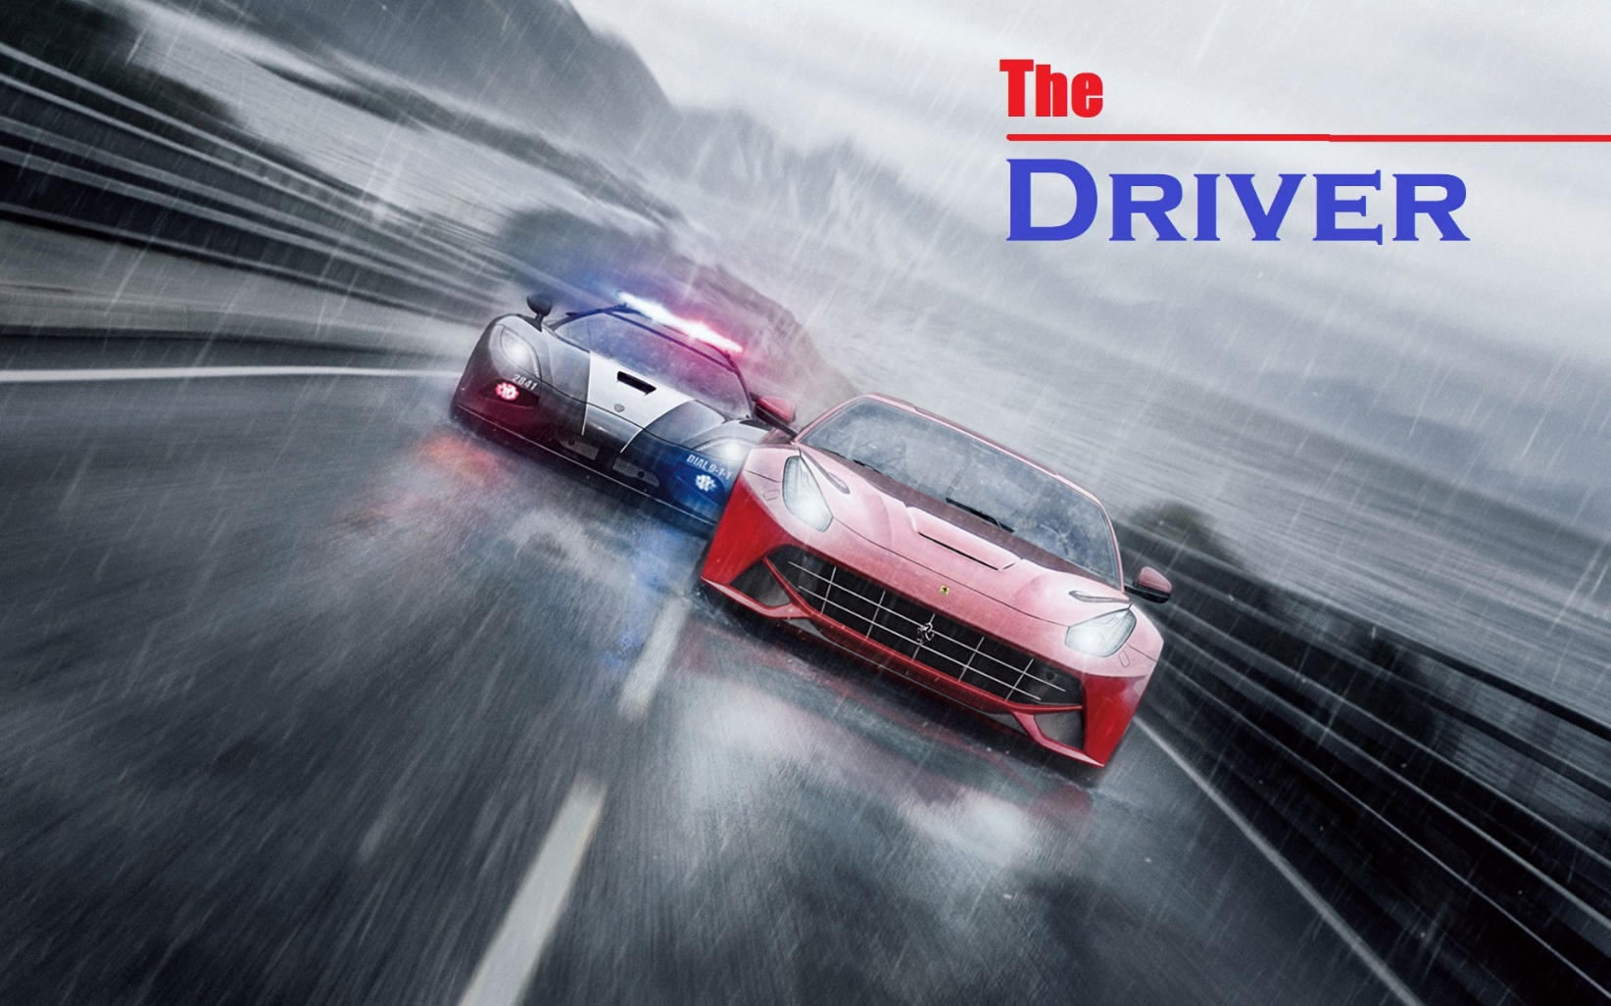
#game for the track lovers
.....which will give multiple way to defeat

Slide 3
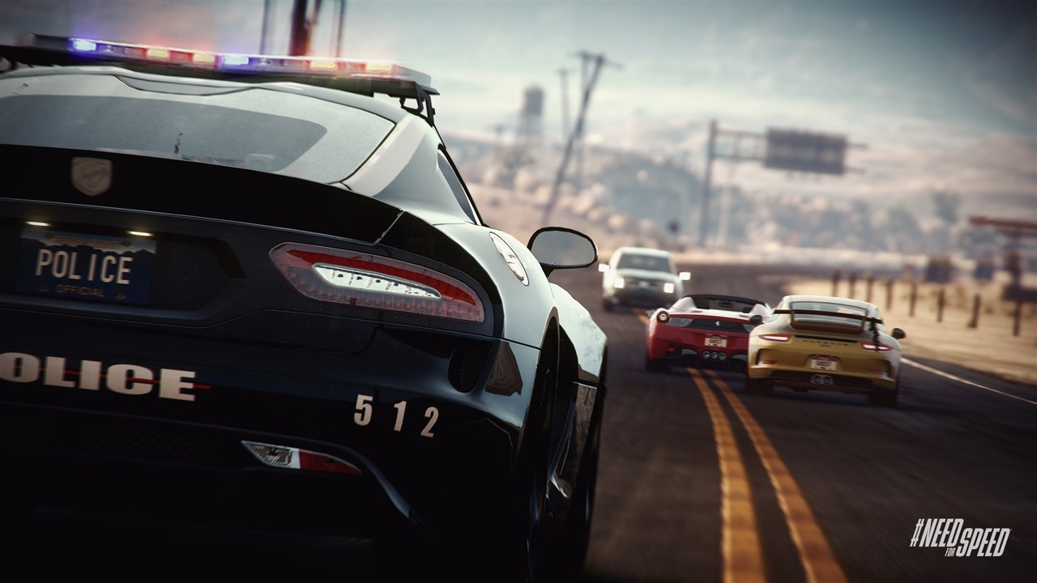

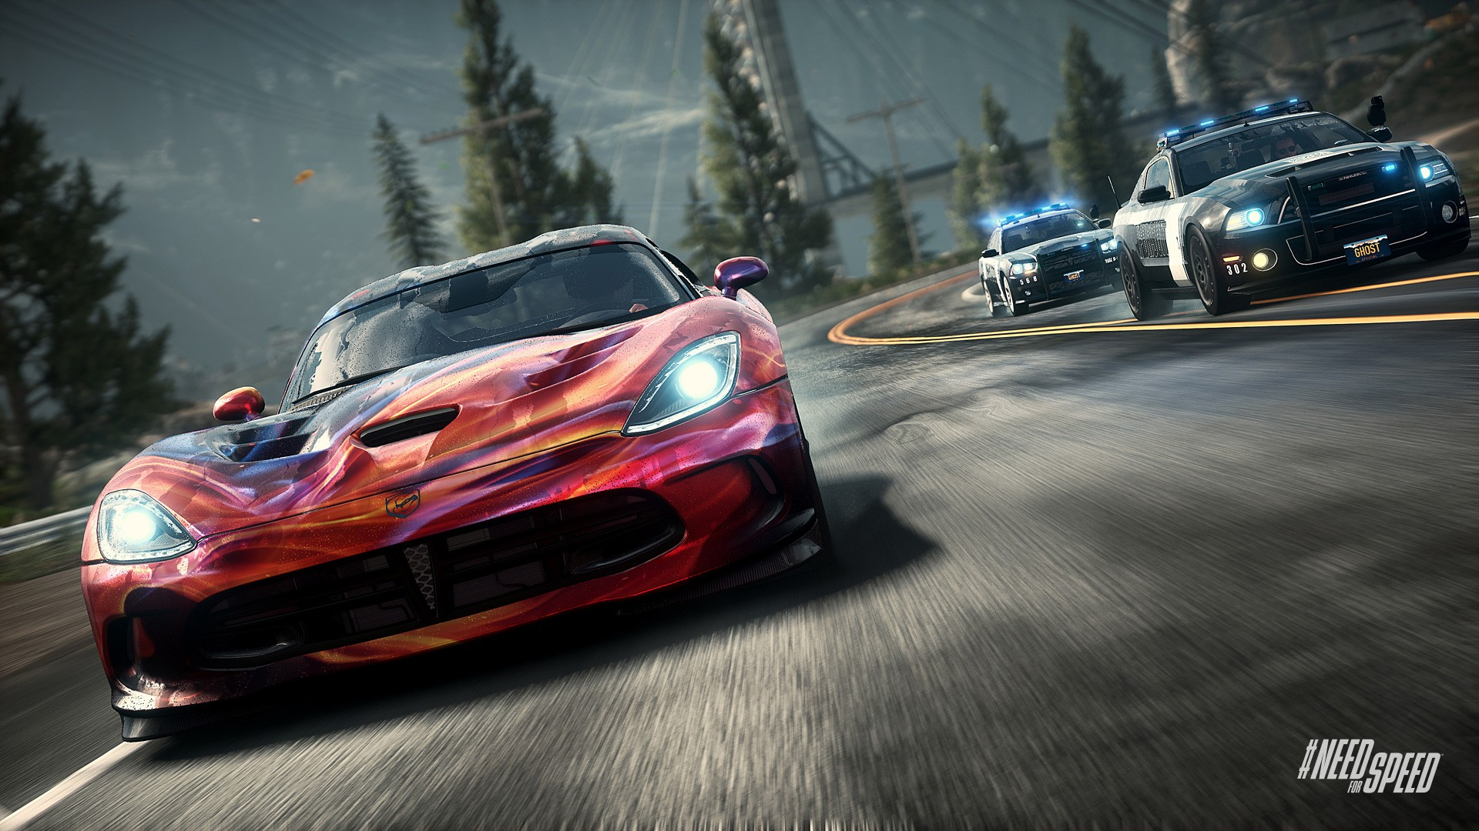
The Driver _ Menu Page
Play as a Cop
CONTROLS
TOP RANK
ABOUT
QUIT
Play as a Racer

Slide 4
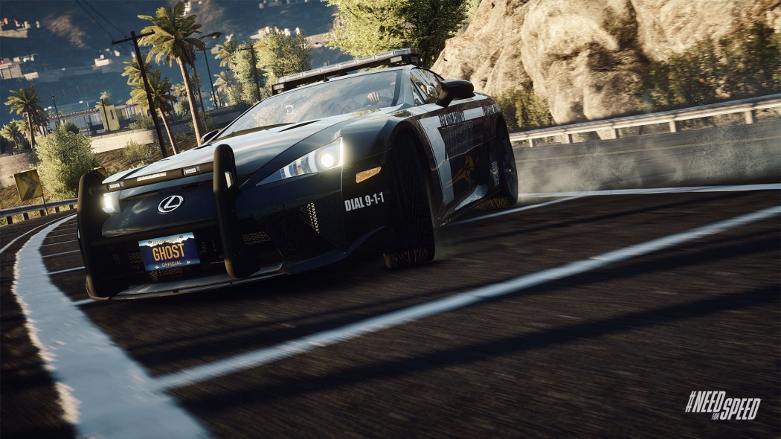
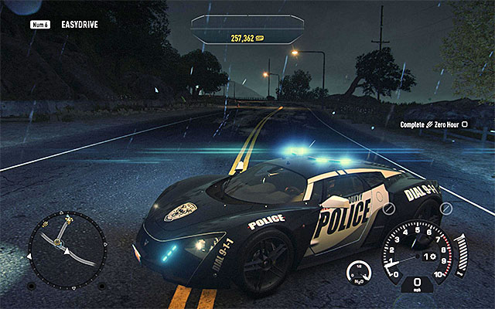
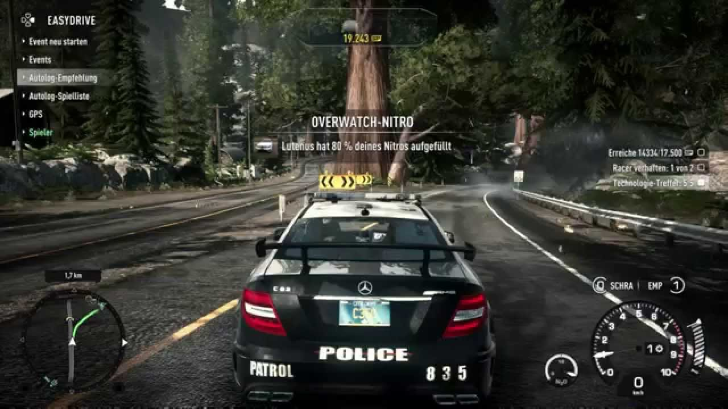
#features:
Play as a COP:
Left Right Turning
Acceleration
Brake
The Driver _ Play as a COP
Add your first bullet point here
Add your second bullet point here
Add your third bullet point here
Left Right Turning
Brake
Acceleration

Slide 5
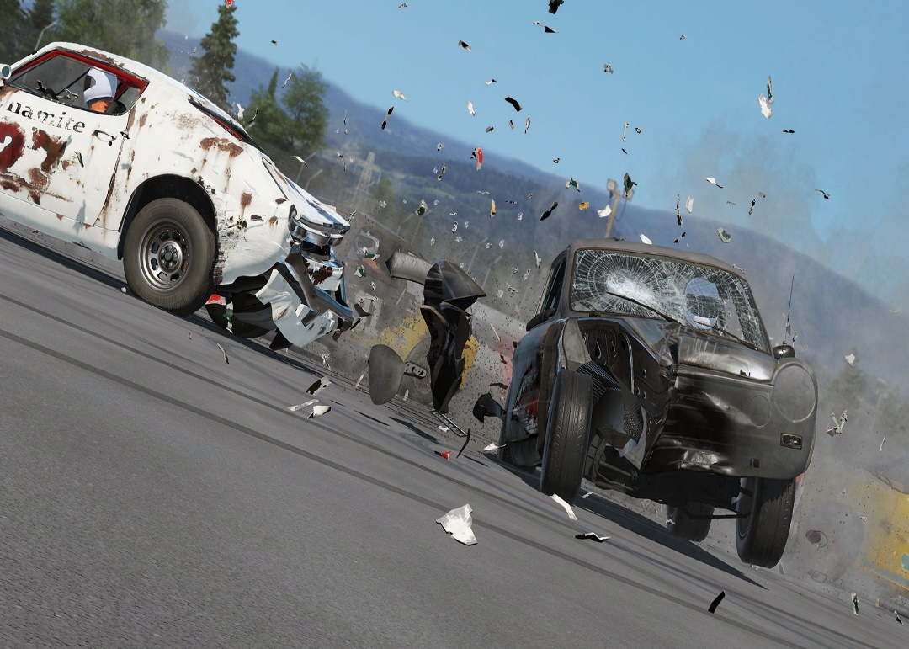
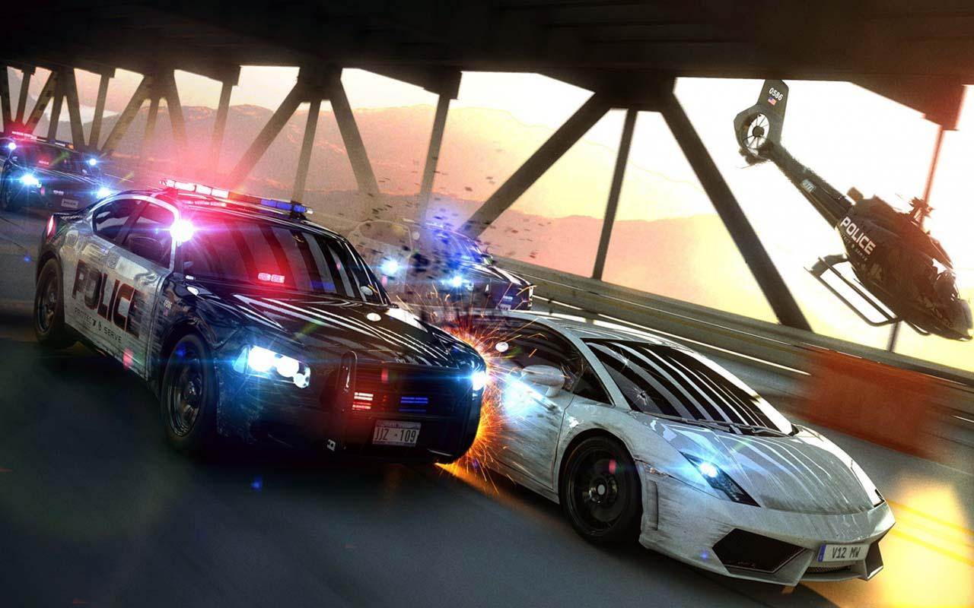
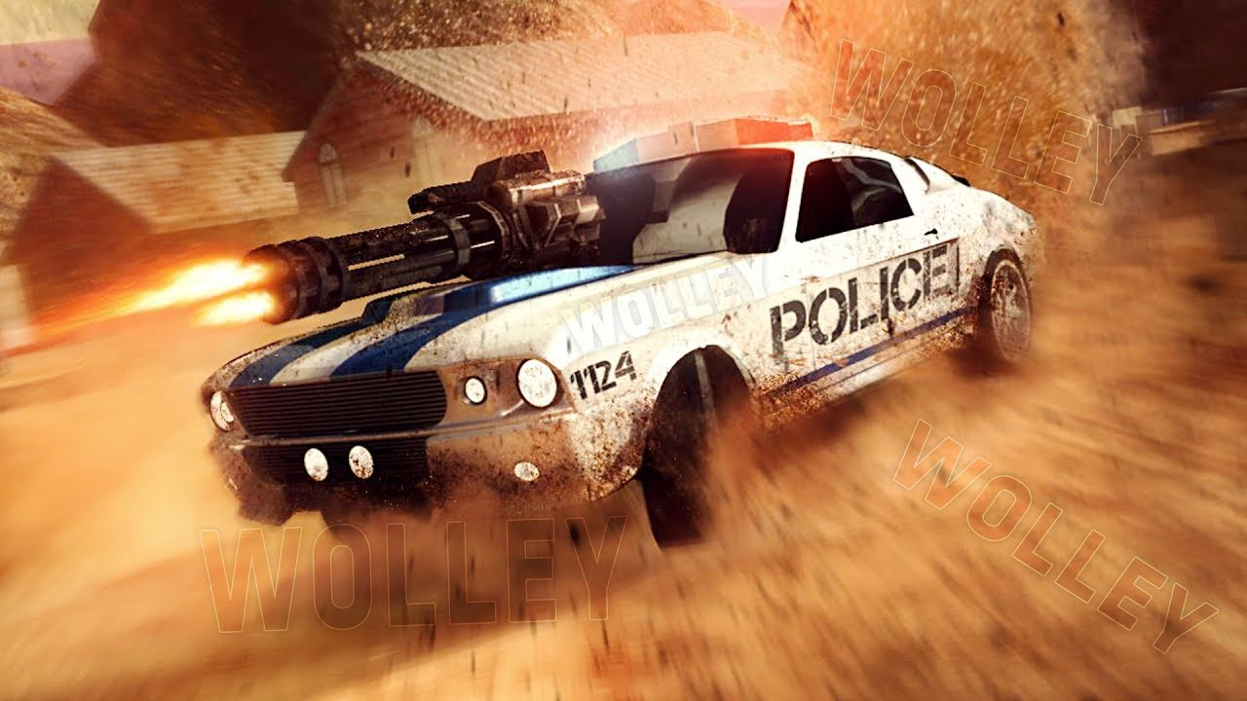
#features:
Play as a COP:
Front to Front Clash
Side Clash
Firing
The Driver _ Play as a COP
Front to Front clash
Side clash
Firing

Slide 6
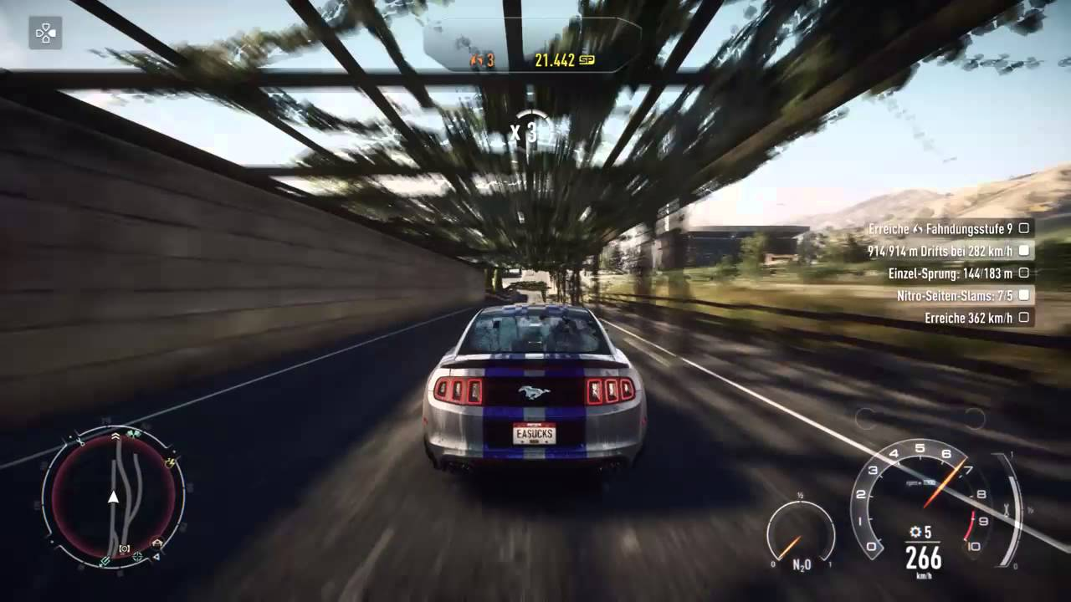
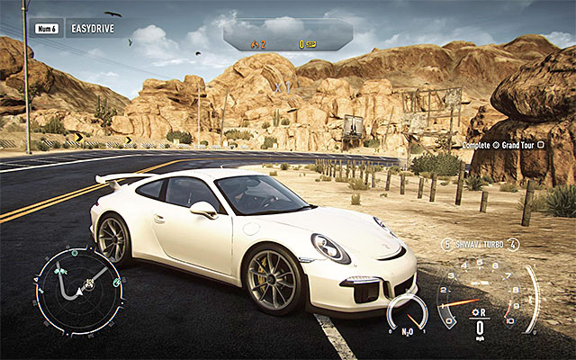
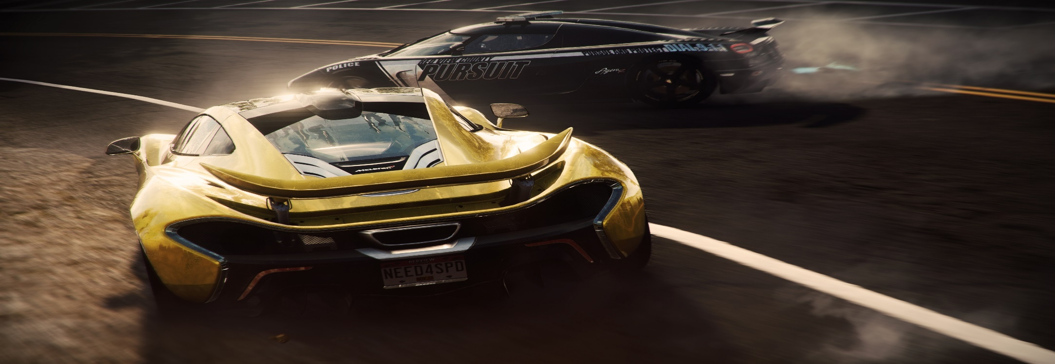
#features:
Play as a racer:
Left Right Turning
Acceleration
Brake
The Driver _ Play as a racer
Acceleration
Brake
Left Right Turning

Slide 7
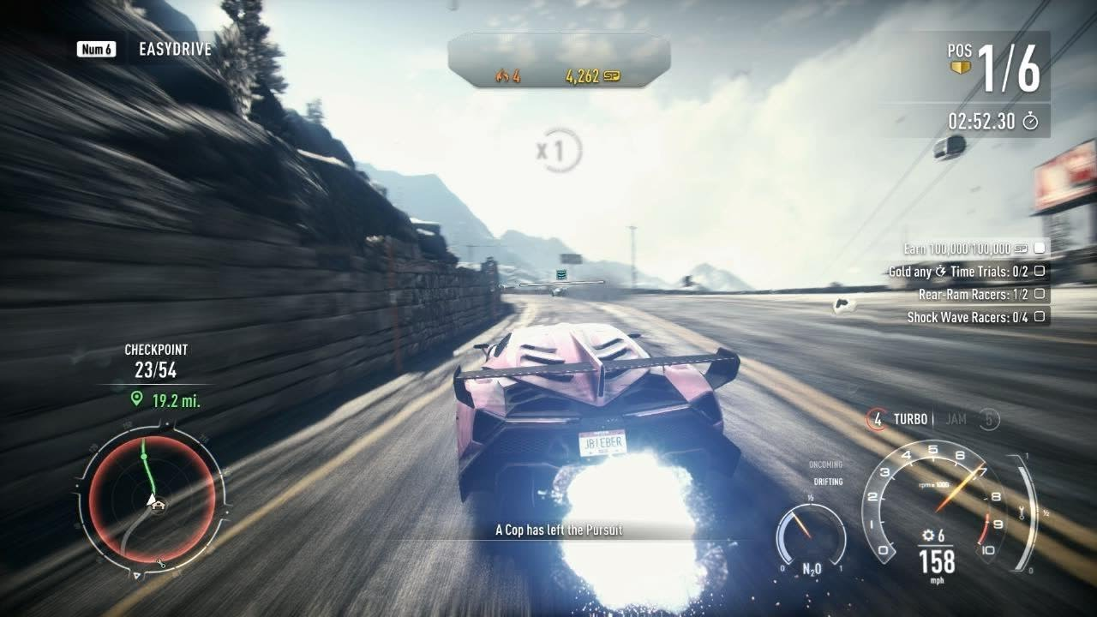
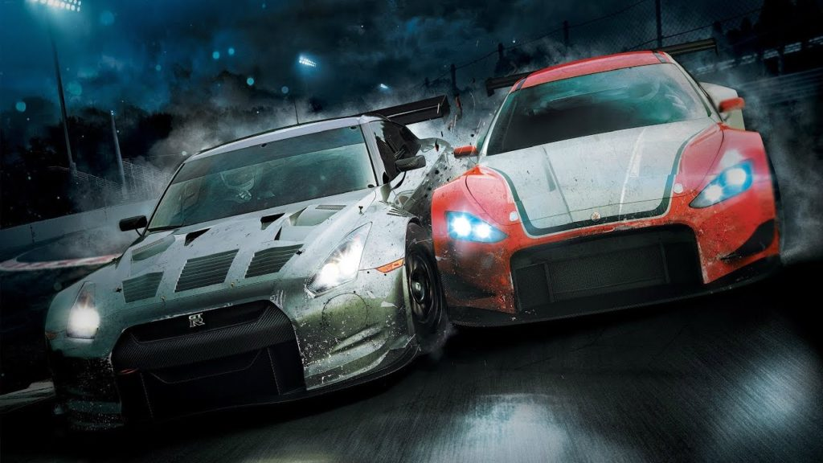
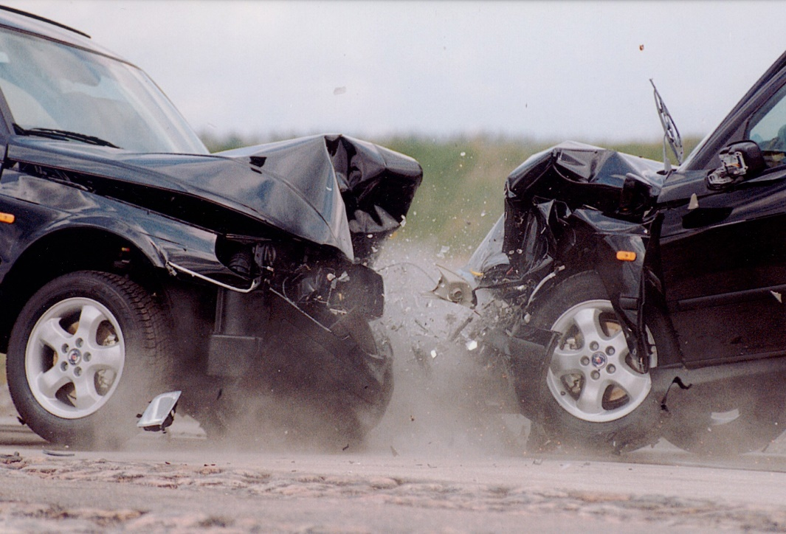
#features:
Play as a racer:
Front to Front Clash
Side Clash
Nitro
The Driver _ Play as a racer
Nitro
Side Clash
Front to Front clash

Slide 8
#How will points come?
How many racers got busted by Firing Side clash How much second he stayed on the track
How many polices got smashed by Side clash How much second he stayed on the track How much he applied nos
For the COP driver:
For the racing driver:

Slide 9
# Key Points
Game will be over by occurrence Front to Front clash
There will be a sound of engine in the background
There will be level variation
Opponent COP will shoot the racer on line

Slide 10
# Application of Methods
File:
Structure:
Header File:
Scoring
Highest Score
Properties of Cars
For using iTimer
Collision of Cars
Objects beside roads
For road divider
For Scoring part
For the COP driver part
For the Racing driver part
For the Menu part

Slide 11
Dewan Tanjil Hossain (17.01.04.072)
Menu Part

Slide 12
Abu Ubaida Akash (17.01.04.060)
“Play as a COP”

Slide 13
Joy Mondal (17.01.04.073)
“Play as a racer”

